Slide 1



E-COMMERCE
MULTI-REGION WEB APPLICATION
GLOBAL BRANDS GROUP

Slide 2



AGENDA
Project Objective & Constraints
Architecture Diagram & Overview
Components & Cost Estimation
Security Measures
Multi-Phase Deployment Plan
Testing & Verification
Summary & Conclusion

Slide 3


PROJECT OBJECTIVE & CONSTRAINTS
Project Objectives:
Build a multi-region e-commerce web application on Azure, ensuring high availability, scalability, and security.
Support mobile app traffic, integrating backend services such as databases, APIs, and App Services for global users.
Project Constraints:
Regions: North Europe and UK South for the multi-region deployment.
Architecture Scope: Deployment of Hub & Spoke VNet, App Services, SQL Database with Geo-Replication, Application Gateway, WAF, DDoS Protection, Private DNS Endpoints.

Slide 4

ARCHITECTURE OVERVIEW
Visual Diagram: High-level diagram showing the architecture components:
Hub VNet: VPN Gateway, Private DNS, Application Gateway (with WAF).
Spoke VNets: App Services (Web and API) in West Europe and North Europe.
SQL Database with Geo-Replication between regions.
Traffic Manager for routing traffic based on health, proximity, and performance.
Key Components:
Hub & Spoke: Centralized management, simplified network security.
Traffic Manager: Ensures global traffic distribution and failover.
Application Gateway: Regional load balancing with WAF for security.
SQL Database: Geo-replication across two regions for high availability.
Private Endpoints: Ensures secure communication within the Azure environment.

Slide 5
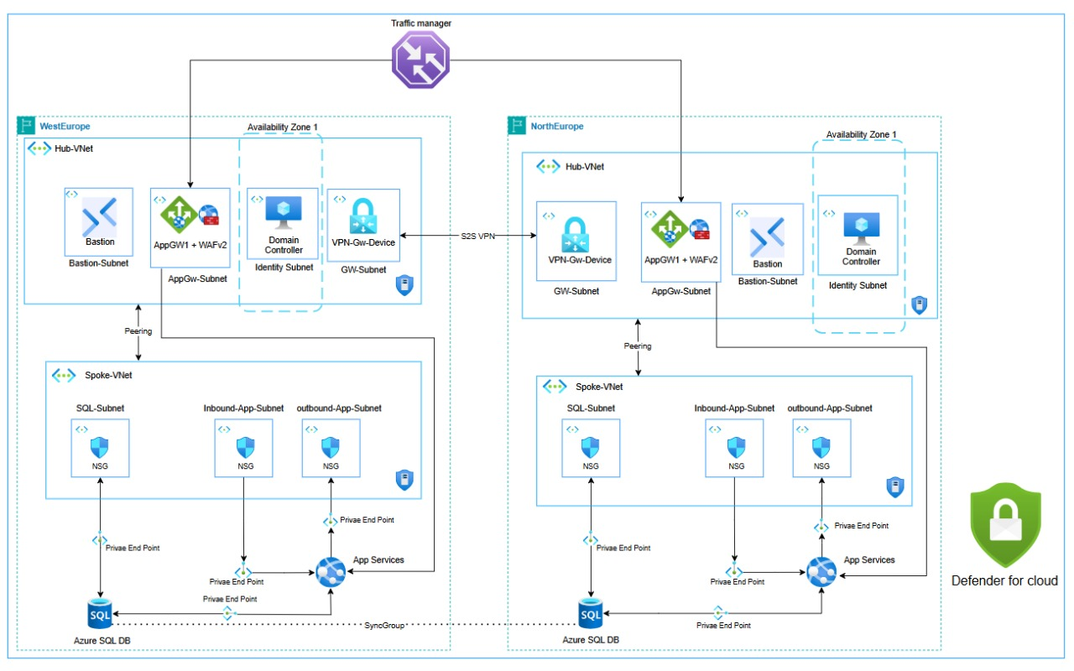
ARCHITECTURE DIAGRAM

Slide 6


SECURITY MEASURES
Web Application Firewall (WAF):
Enabled on Application Gateway to protect against common vulnerabilities (e.g., SQL injection, cross-site scripting).
DDoS Protection:
Standard DDoS Protection deployed to mitigate large-scale threats and ensure uptime.
Azure Defender:
Active monitoring and protection for App Services and SQL Database.
Private Endpoints:
Secure communication between App Services and SQL Database using Private Endpoints to avoid exposure to the public internet.

Slide 7
MULTI-PHASE DEPLOYMENT PLAN
Phase 1: Planning and Design
Phase 2: Deployment
Phase 3: Testing
Phase 4: Monitoring and Scaling

Slide 8

TESTING & VERIFICATION
Global Traffic Routing:
Test Traffic Manager’s DNS resolution and ensure it routes to the nearest region based on latency or health.
Failover Testing:
Simulate a failure in Region 1 (App Service or SQL Database) and ensure Traffic Manager routes traffic to Region 2.
Private Endpoints Connectivity:
Verify that App Services in both regions can connect to the SQL Database using Private Endpoints.
Monitoring Setup:
Test Azure Monitor and ensure all components are reporting health and metrics.

Slide 9
CONCLUSION & SUMMARY
This architecture structure ensures that you convey your architecture, design choices, and deployment steps in a clear, professional manner. Each slide serves to explain the key aspects of your e-commerce cloud infrastructure on Azure.

Slide 10

THANK
YOU

